Slide 1
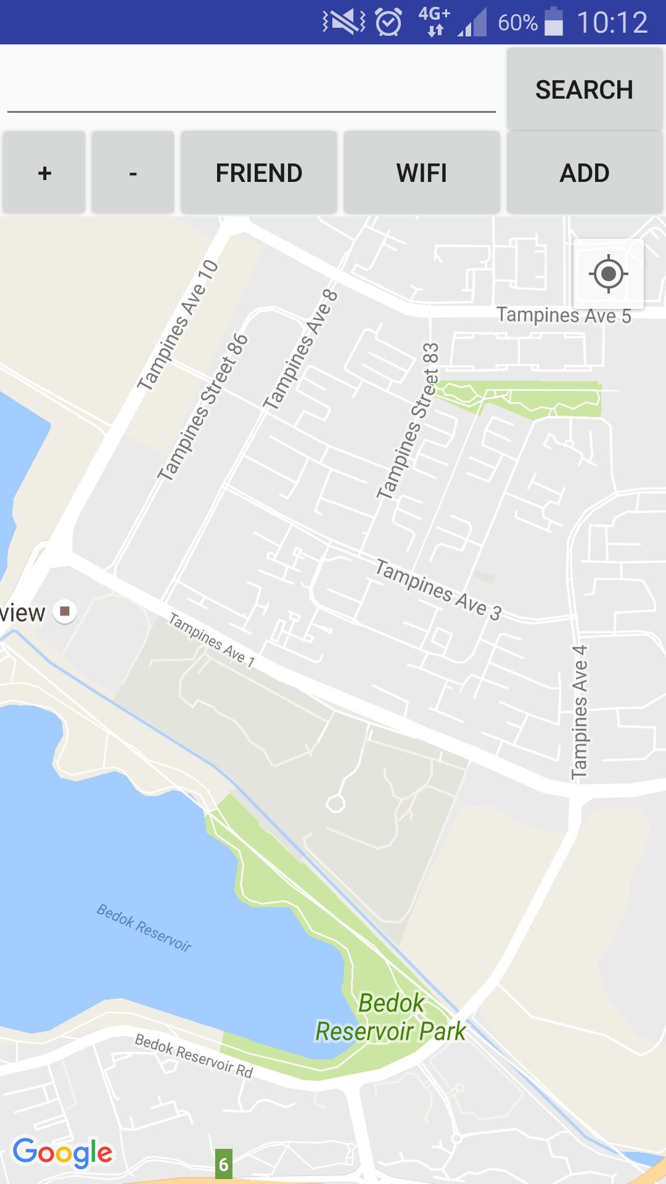
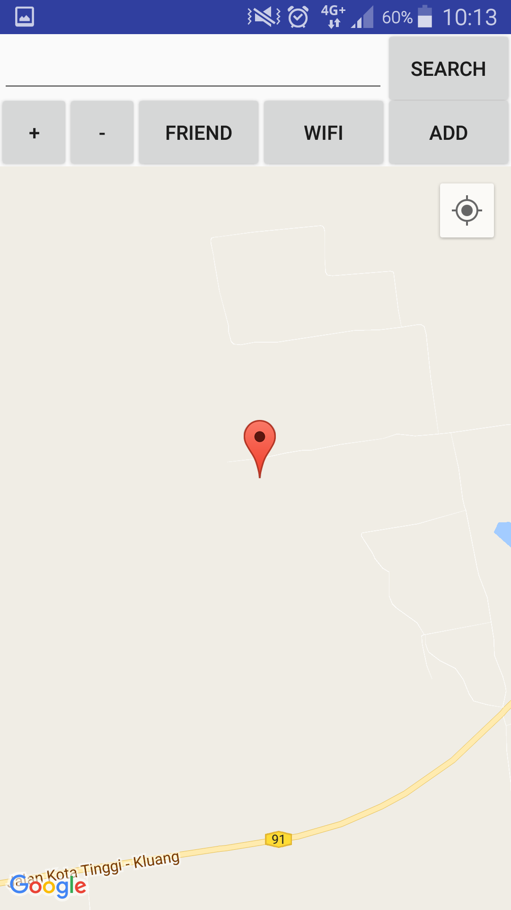

GPS and Wi-Fi Location Tracker
Project No: 1B16412
Students: Pow Rei Young
Supervisor: Mr. Teo Tse Tsong[TP]
Project Description
This project was started and created to develop a software application that can help and locate the elderly at anytime. Using Java programming language, PHP programming language and Android Studio, two different applications were created that uses two different methods. With these applications, they will help users to locate the elderly with GPS and Wi-Fi information.
Main Page of Server App
Key Features
Can display location information on the map
Can detect and display Wi-Fi information in the application
First application uses SMS method to send and receive information
Second application uses OpenShift server to communicate information
Able to display location
Computer Engineering Diploma Unit
Notes:
White Background
Vertical Photo Display

